Slide 1
Represented by: Rabia Naseer Challan no(302655)
Climate change is a reality or Myth

Slide 2
Climate Change a Global issues
“The greatest challange facing the world at the begining of the century”

Slide 3
Climate Change:
UNFCC defines climate change as
“A change of climate which is attributed directly or indirectly to human activity that alters the composition of the global atmosphere and which is in addition to natural climate variability observed over comparable time periods “( United Nations,1992)

Slide 4
CHANGES IN ATMOSPHERIC COMPOSED OF GHGS

Slide 5
UNFCCC Ultimate Objective
“The ultimate objective of this convention and any related legal instruments that the conference of the parties may adopt is to achieve.

Slide 6
Stabilization of greenhouse gas concentrations in the atmposphere at a level that would prevent dangerous anthropogenic interference in the climate system.
Such a level should be achieved within a time-frame sufficient to allow ecosystems to adopt naturally to climate change,to ensure that food production is not threatened and to enable economic development to proceed in a sustainable manner.”

Slide 7
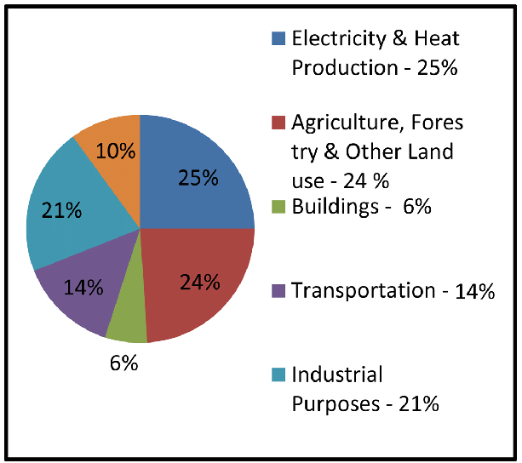
GLOBAL EMISSIONS BY SECTORS

Slide 8
PAKISTAN,S SATATUS AS A GHG EMITTER
Based on the data for the year 2000,pakistan,s contribution GHG emission is a miniscule(about0.8%)
Pakistan is ranked at 135th place on the basic of its per-capita GHG emission without land-use change and ^{14th} palce when land-use change is also taken into consideration (US-DOE2009)
In 2008 pakistan,s per -capita GHG emission were 0.76 t_{CO2} compared to 19.7 in USA 3.7 in chuna 1.0 in india
The sector-wise contribution of GHG emission in pakistan during 2007-2008 stood at:
Sector Contribution to total emission in pakistan
Energy 50.7%
Agriculture and livestock 38.8%
Industrial processes 5.8%
Forestry and land use change 2.9%
Wastes 1.8%

Slide 9
The sector-wise contribution of GHG emission in pakistan during 2007-2008 stood at:
Sector Contribution to total emission in pakistan
Energy 50.7%
Agriculture and livestock 38.8%
Industrial processes 5.8%
Forestry and land use change 2.9%
Wastes 1.8%

Slide 10
GLOBAL VS PAKISTAN -MEAN TEMPERATRENDS
PERIODS | GLOBAL(AR4,2007) | PAKISTAN
1901-2000 | 0.06 c | 0.06 c
1956-2005 | 0.128 c | 0.16 c
1971-2005 | - | 0.26 c
1981-2005 | 0.177 c | 0.39 c
1991-2005 | - | 0.74 c

